Slide 1
Investigating the suitability of Image Sequence Prediction to Predict Armed Conflict
Gareth Lomax
In collaboration with COALA
Notes:
Hello,
Thankyou
Discussing use of Convolutional LSTM image prediction
In armed conflict in Africa

Slide 2
Agenda
Motivation and Introduction to conflict analysis
Overview of ConvLSTM theory
Discussion of dataset production model training
Discussion of results in context of conflict detection.
Notes:
Introduction of conflict – necessary to know for design choices
CONVLSTM – theory behind image sequence predciton
Dataset produced – image sequence
Discussiong and comparison to state of the art and what this means for prediction
GOALS
SPATIAL MODELLING
-> CONV LSTM

Slide 3
Conflict
Quantitatively Studied since 1960s
Modelling methodology:
ABM
Statistical Model Fitting
Logistic regression, RF
Conflict event frequency in UCDP GED 19.1 dataset. Data: Croicu and Sundberg [2017]
Notes:
Conflict analysis and prediction –
ABM and statistical model fitting – investigate role of conflict causation systems and role of individual conflict predictors.
Range from economic and statistical analyses in india
To multi layer network models coupled with AMB.
HOLY GRAIL IS PREDICTION.
NON ML identify predictors
ML most useful in preduction
Conflict has increased over last years.
And has been found to couple with climate change.
-TEMP PRECIPITATION, MIGRATION, ECONOMIC SHOCKS.

Slide 4
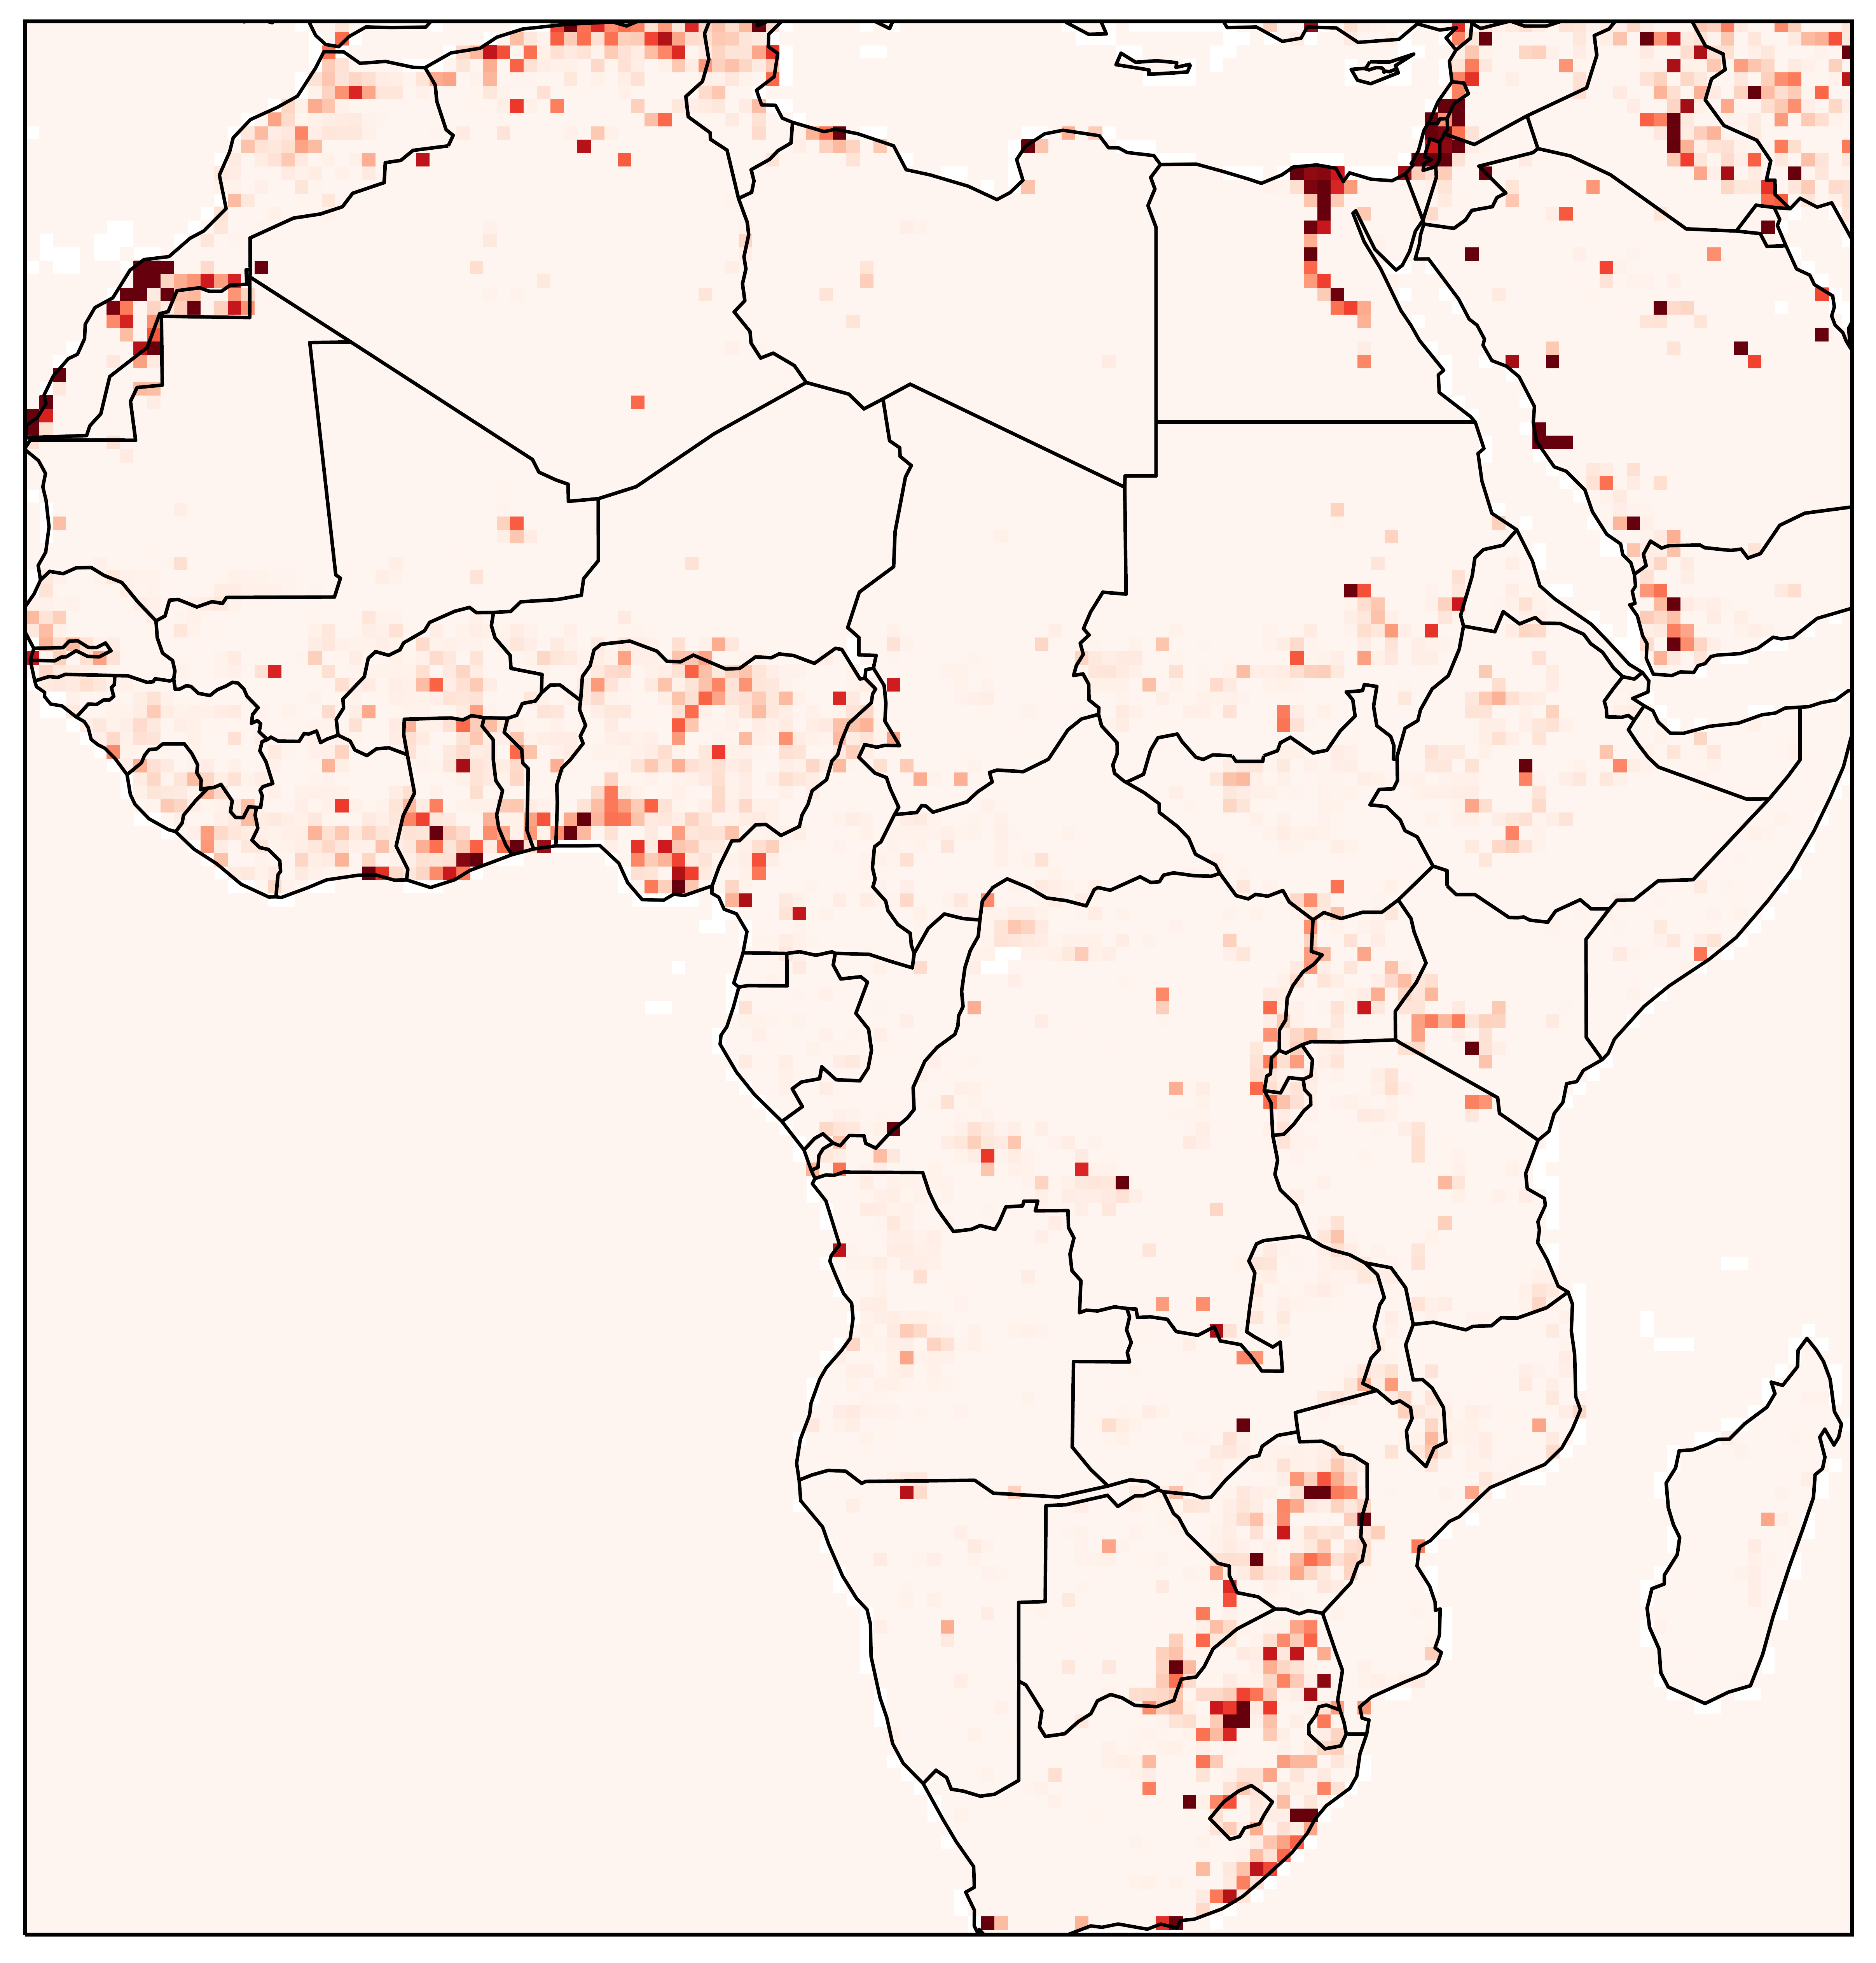
Datasets
Disaggregated datasets have allowed subnational analysis.
PRIO encodes 0.5 x 0.5 degree grid, of monthly varying conflict predictors.
Separable in 4 themes: conflict, environmental, socio-economic, political.
UCDP records battle attributed deaths due to armed conflict 1989 – present.
UCDP events – battles in between two or more clearly defined groups with a stated incompatibility in a conflict with above 25 total battle related deaths.
Visualisation of intensity of urban ground coverage across Africa by PRIO grid cell. Data: Tollefsen et al. [2012]
Notes:
Ucdp
EVENT – 25 BATTLE DEATHS 2 PARTIES STATED GOAL
PRIO
0.5 0.5 GRID
URBAN IH, PRECIPITATION, POP, ECT.

Slide 5
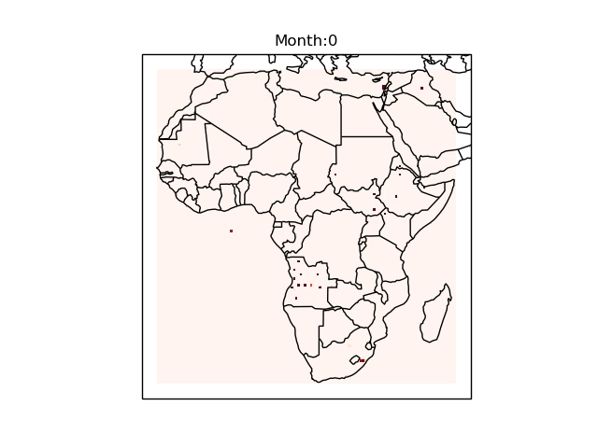
Spatial Diffusion
Disaggregated datasets have demonstrated that conflict may diffuse and transmit across borders.
Current efforts do not utilise spatial structuring of conflicts.
First order spatial lags for feature engineering – current state of the art.
To exploit the structural information we require deep spatiotemporal networks.
The project goal:
To utilise the spatial structuring of the conflict data to produce superior predictions.
Frequency of UCDP events per PRIO grid cell across Africa per month since Jan 1989.

Slide 6
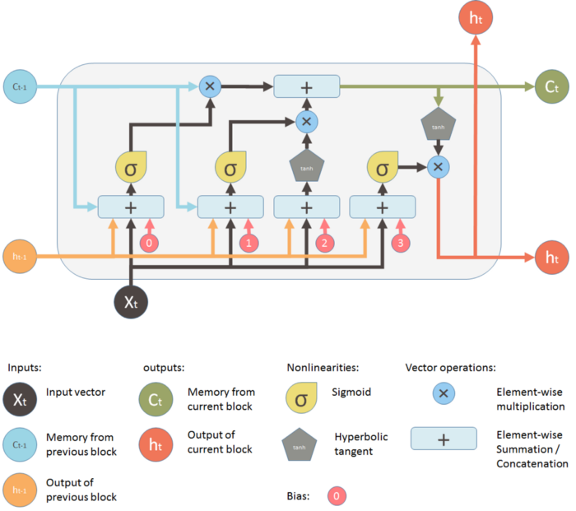
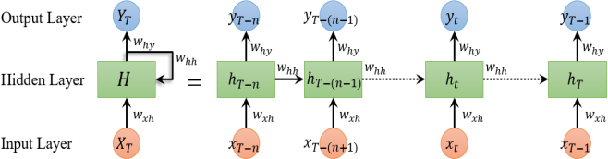
RNNs
RNNs introduce recurrent hidden layers to neural networks.
Hidden layers allow information to pass through different sequence steps
Visualisation of unrolled RNN. Image source: Cui et al. [2018]
Visualisation of LSTM unit gates. Image source: Shi [2019]
Notes:
Equations from report – mention how constantly updated. – this leads to issues – gradient vanishing exploding and cant tell which part is relevant.

Slide 7
LSTM vs ConvLSTM
Lstm – adaption of rnn
Rnn example sequence -> include equations
Lstm gate architecture -> with highlighting animations, describing function of gates.
LSTM introduces cell memory, and forget gate. Information may persist over far greater time periods.
Conv LSTM respects spatial layout in state to state transitions.
Notes:
Connections are simply a vector in normal lstm
In ConvLSTMs

Slide 8
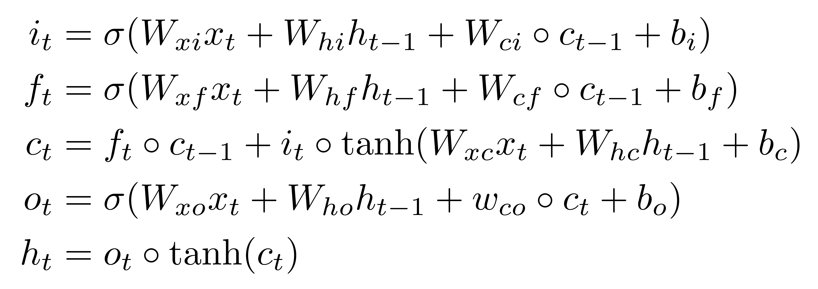
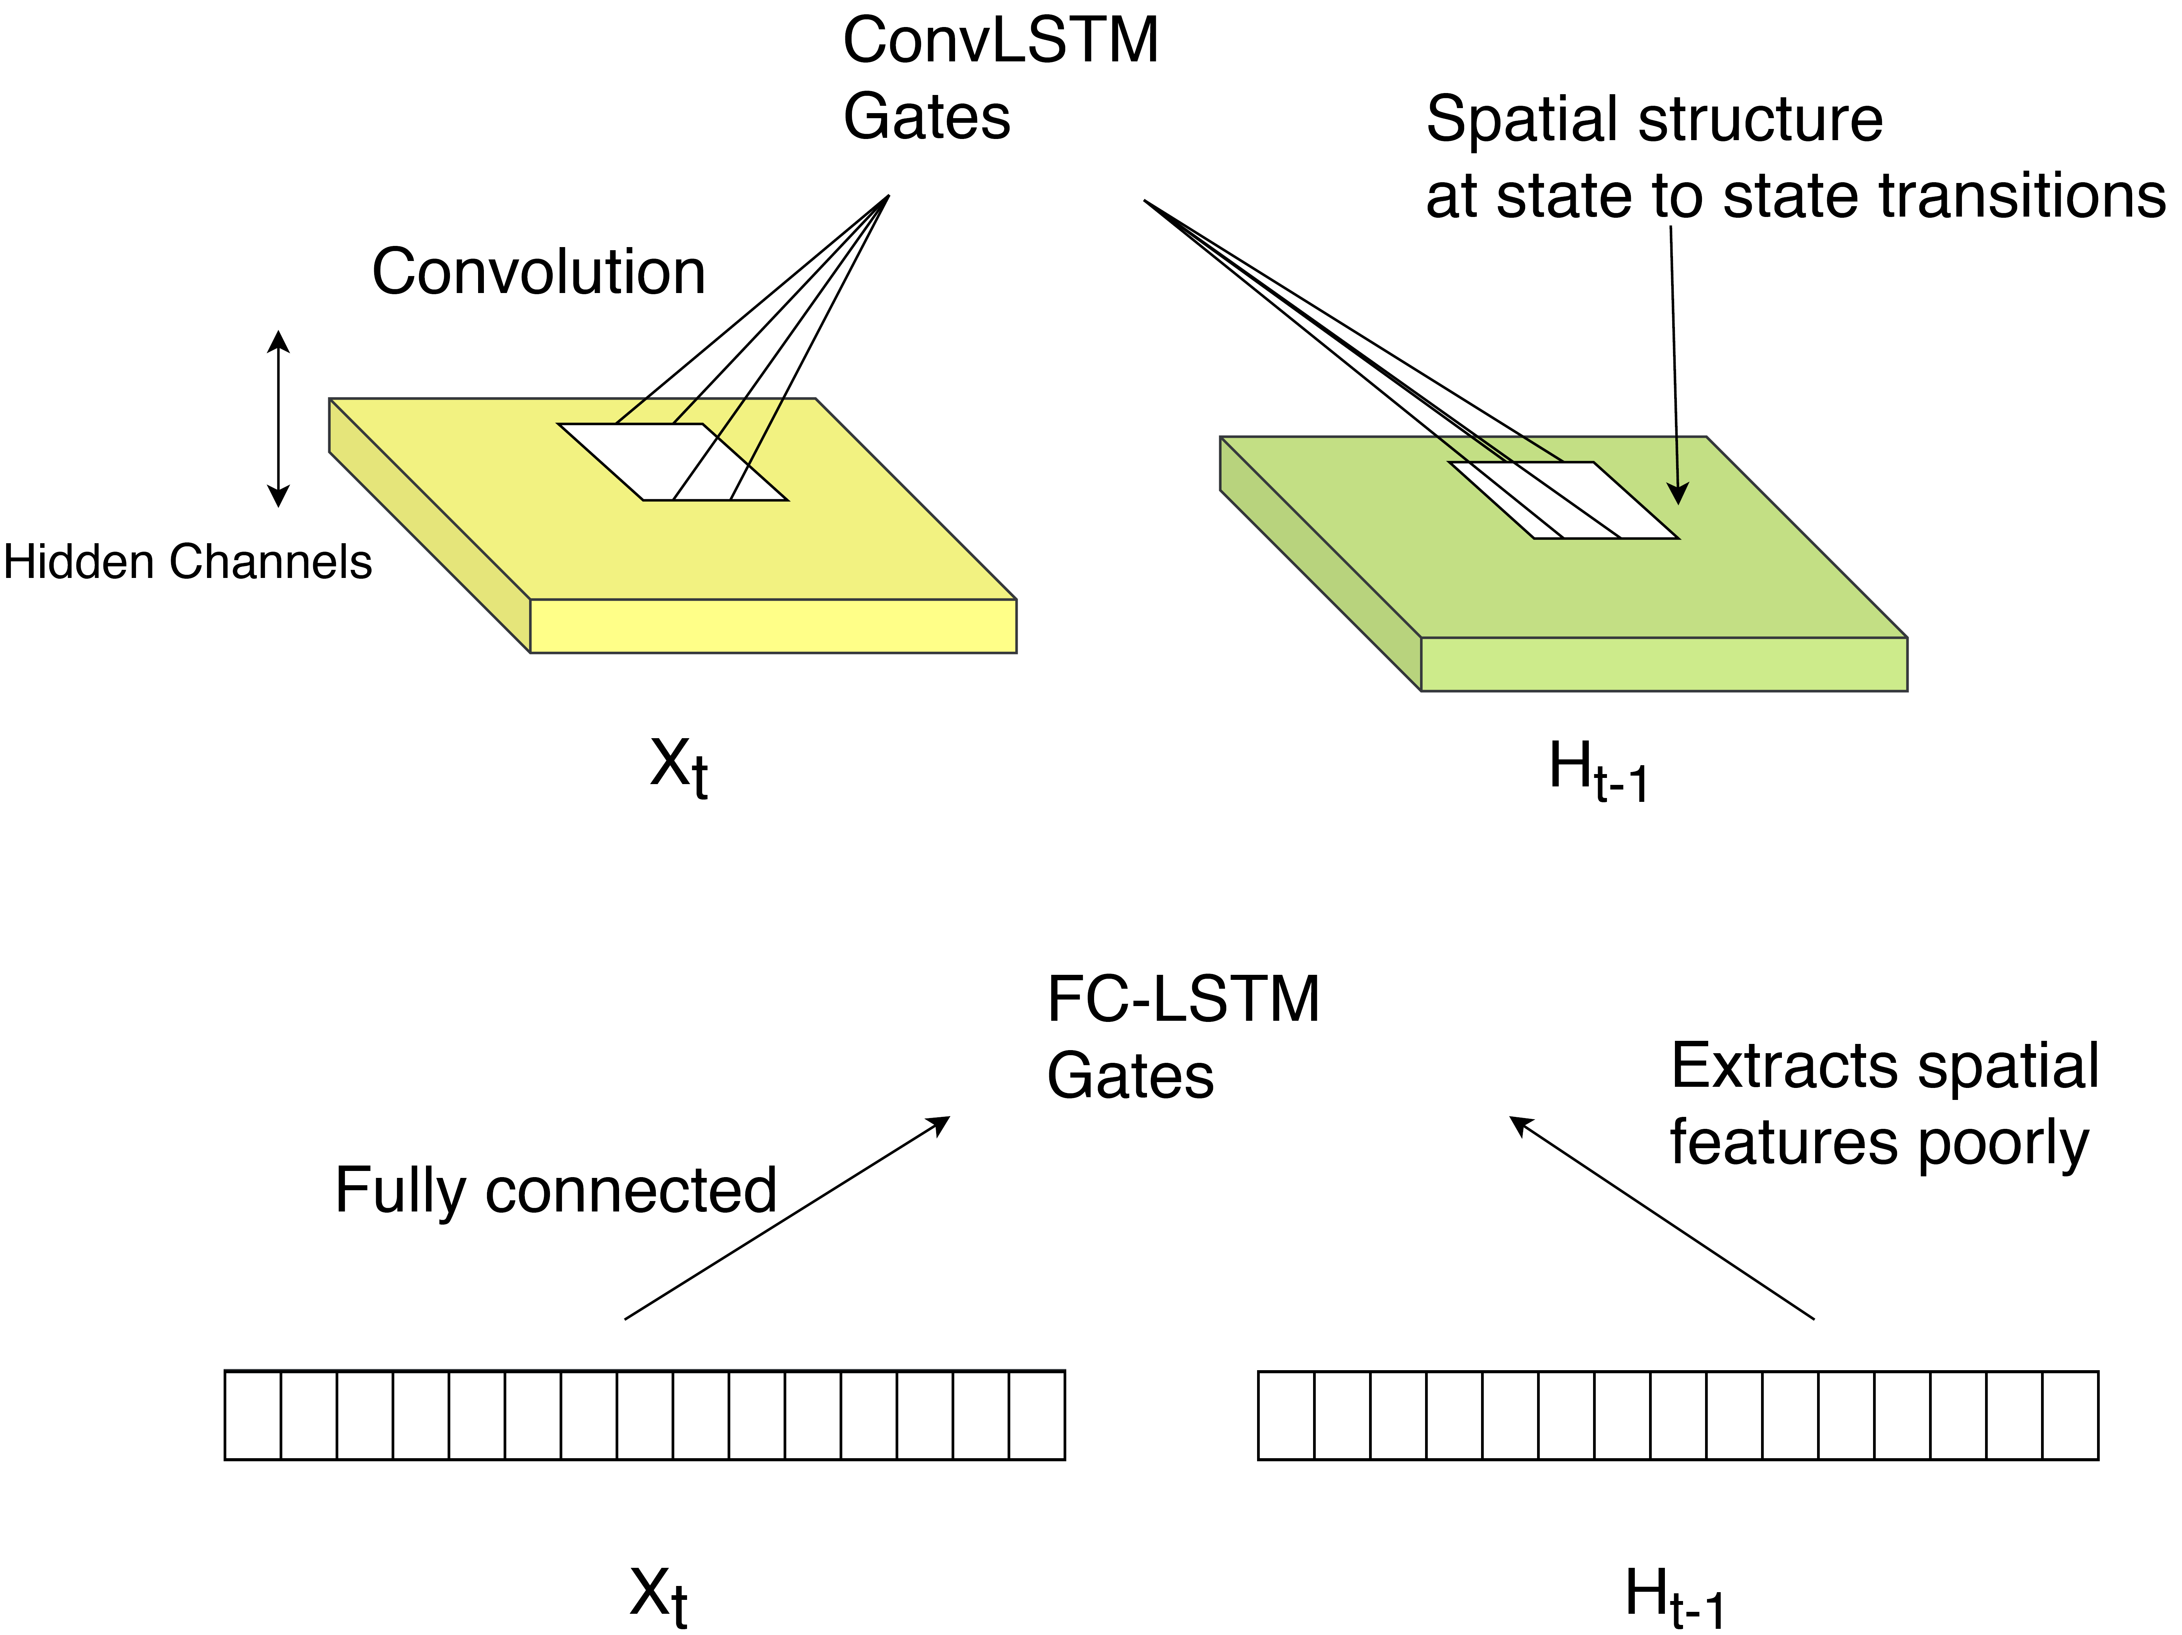
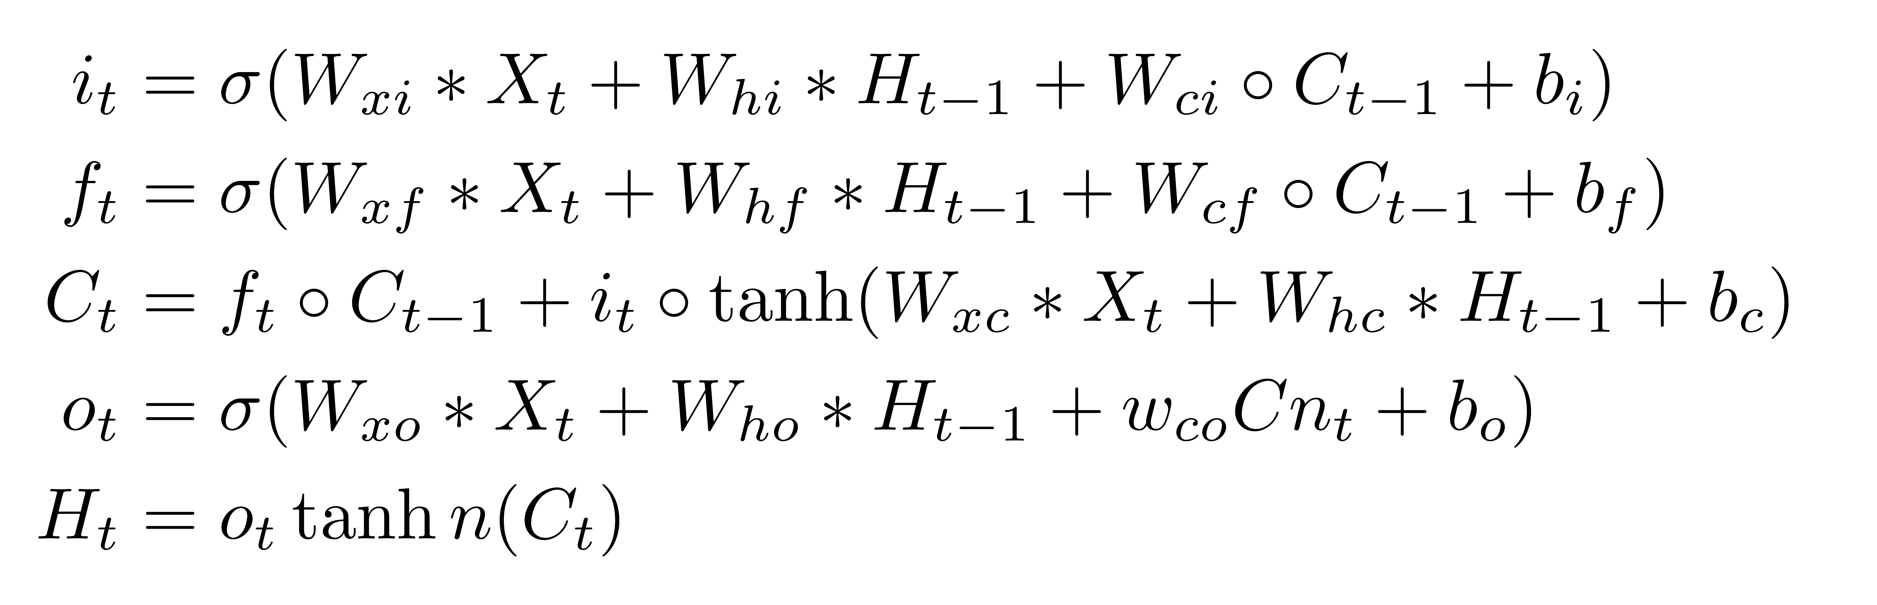
ConvLSTM
FC-LSTM gate equations Shi et al. [2015]
ConvLSTM gate equations Shi et al. [2015]

Slide 9
ConvLSTM
FC-LSTM gate equations Shi et al. [2015]
ConvLSTM gate equations Shi et al. [2015]

Slide 10
Encoder-Decoder format
Allows for input output sequence length heterogeneity
Final encoder hidden state is a fixed length representation of temporal input
Optimum structure:
Encoder Channels | Decoder Channels
12,24 | 24,12,6,5
Visualisation of unfolded Encoder – Decoder model

Slide 11
Dataset construction
Isolate conflict events by yearly clustering
Introduce conflict event threshold to isolate temporally
Kmeans, Agglomerative, Meanshift, Affinity propagation and KNN algorithms were trialled.

Slide 12
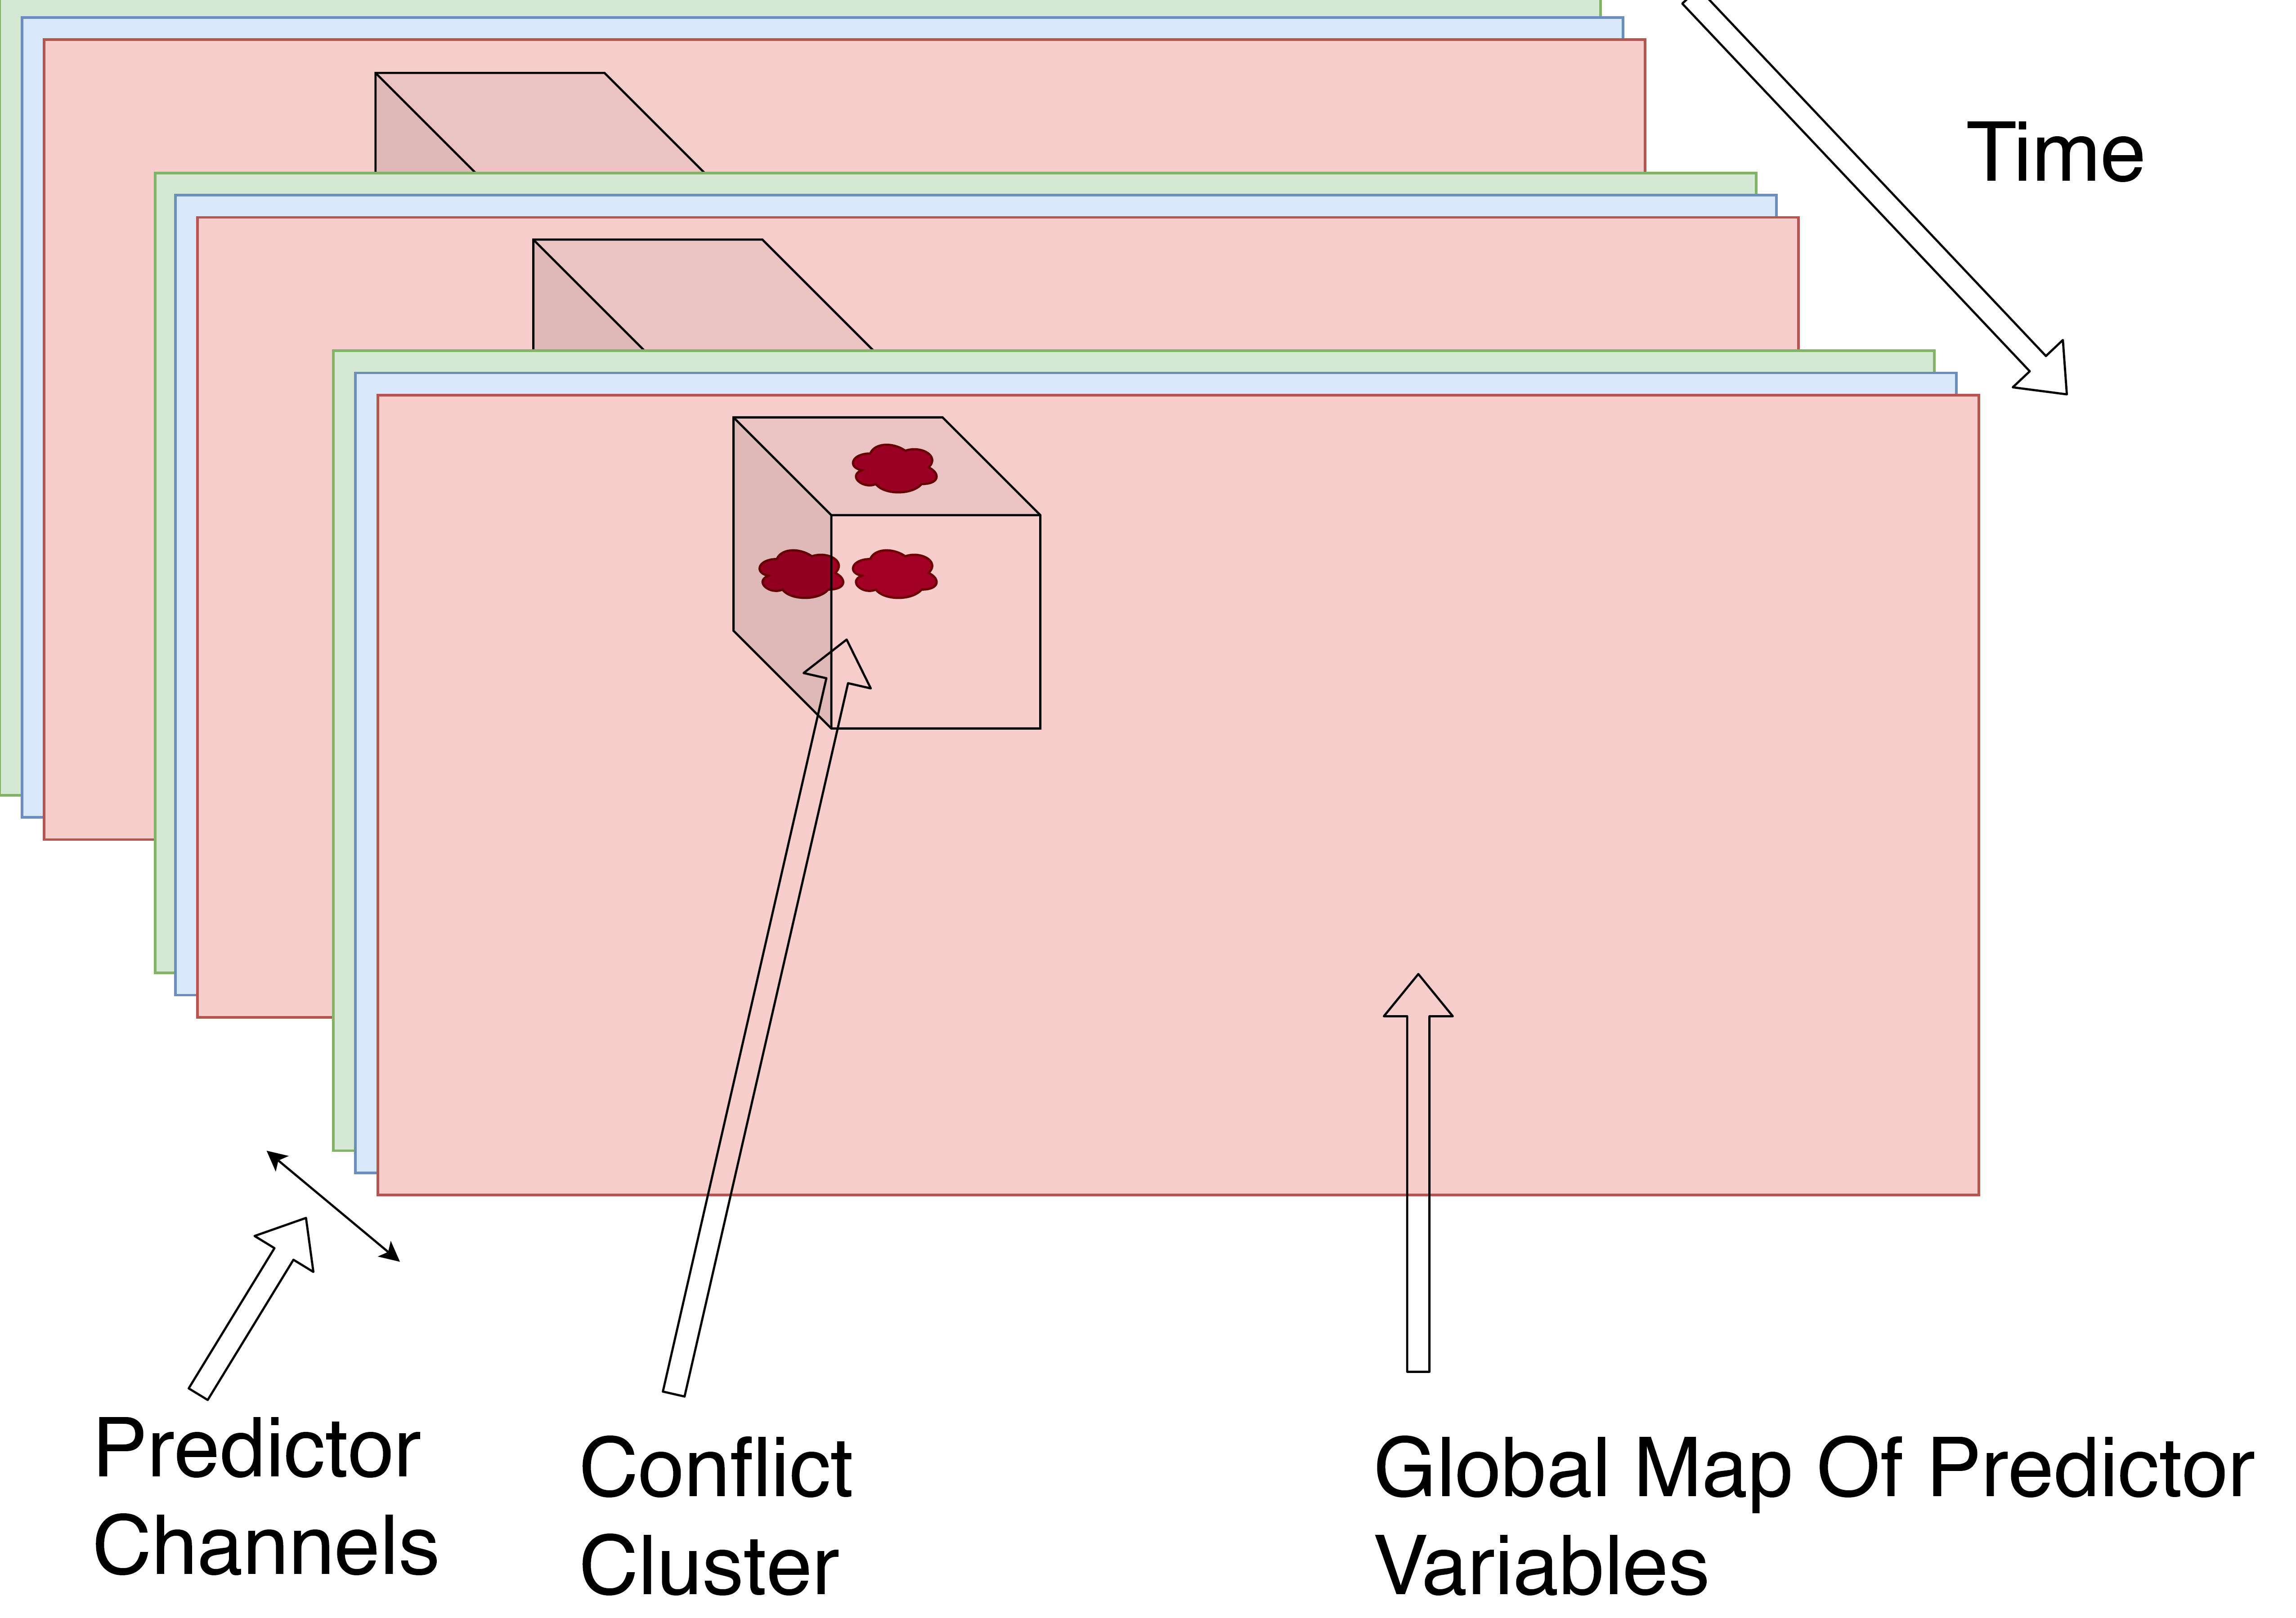
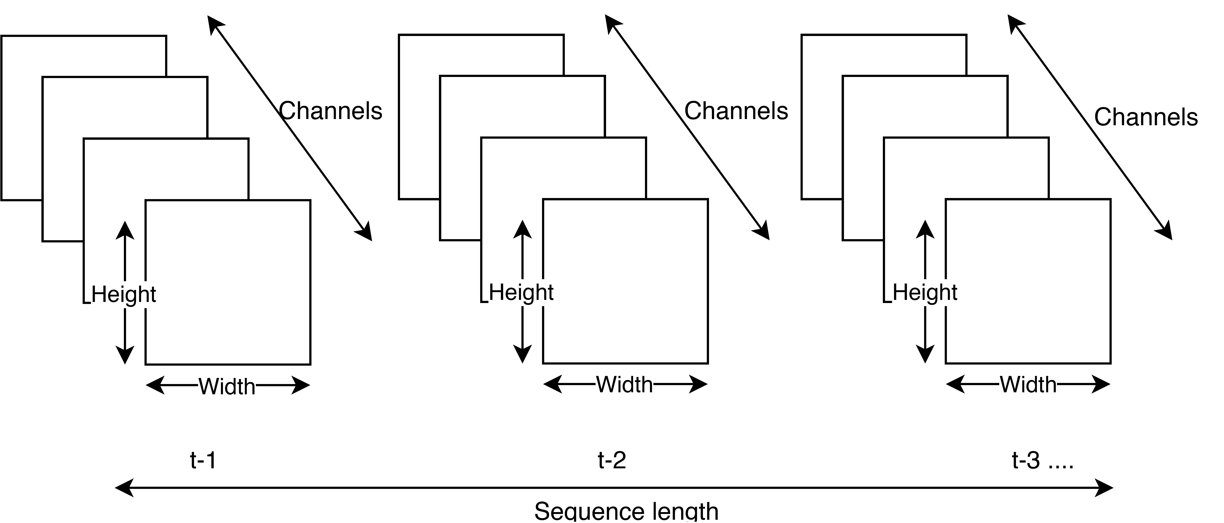
Visualisation of intensity of urban ground coverage across Africa by PRIO grid cell.
Extraction of data formats from global PRIO and UCDP data. Conflict clusters are selected using K nearest neighbours.
Diagram of Image sequence construction process

Slide 13
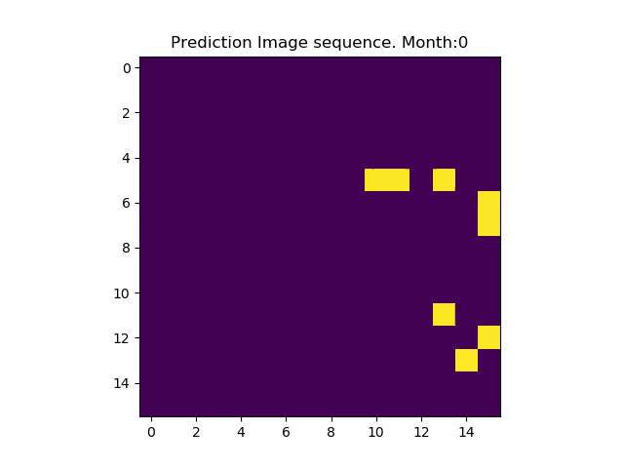
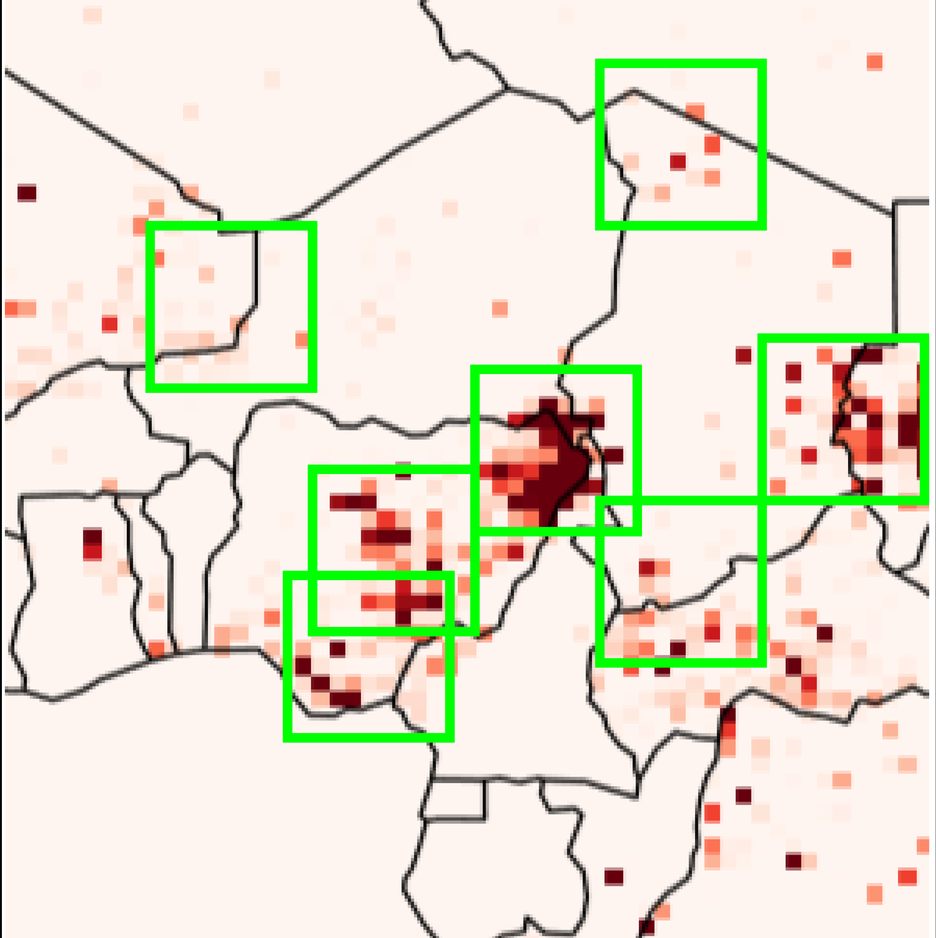
Visualisation of selected conflict clusters in the year 2000, selected between Central and Western Africa
Visualisation of Conflict prediction sequence. 1st channel of prediction image encoding binary battle presence.

Slide 14
Training + Results
Training data split temporally, allowing accurate analysis on most recent data.
AMSgrad with learning rate 10⁻³ outperformed ADAM, RMSprop and SGD.
Final Dataset sizes: 57638 sequences (economic shock), 54496 sequences (population distribution)
 | Training | Validation | Test
Temporal Selection | 01/01/1989 – 31/12/2011 | 01/01/1989 – 31/12/2011 | 01/01/2012-31/12/2013
Economic Shock Predictor Theme | Population Distribution Theme
Binary UCDP Event Variable | Binary UCDP Event Variable
Best Estimate Deaths per month | Best Estimate Deaths per month
Oil Production Yearly | Grid Cell Population (HYDE data)
Drug Production Yearly | Cell Distance To Capital
Average Precipitation | Average Precipitation

Slide 15
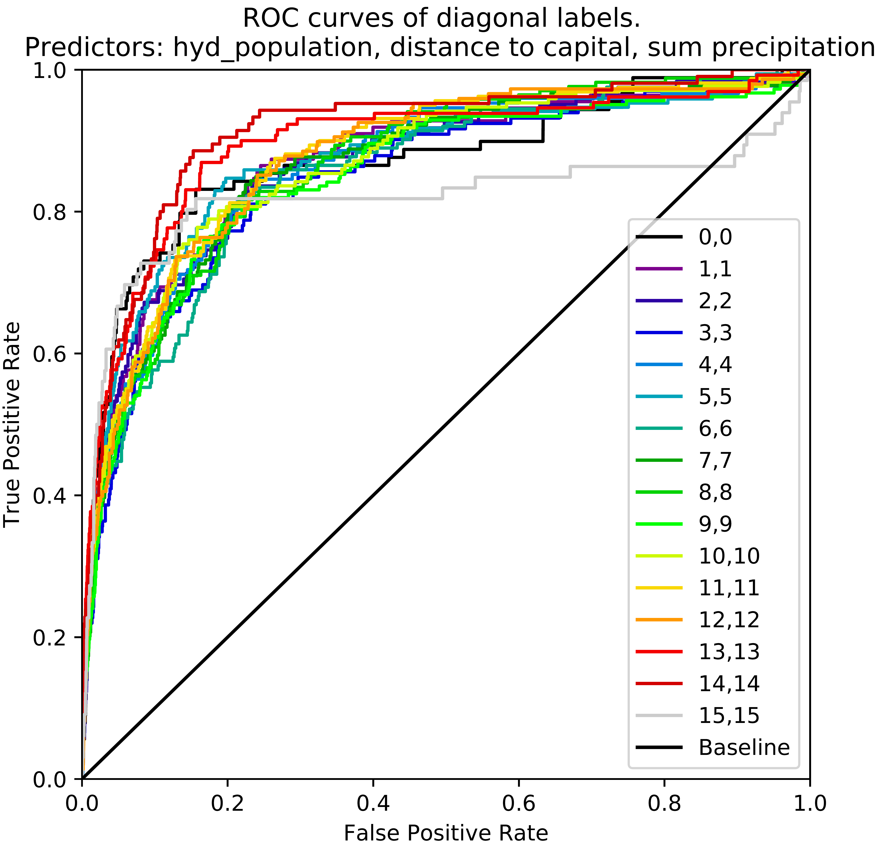

Slide 16
Loss function variance
Mean squared error , multilabeled binary cross entropy and structural similarity loss functions were considered.
MSE lead to over prioritisation of blank space.
Introduction of BCE significantly improves model performance, with introduction of individual label weights.
MSE prediction
BCE prediction

Slide 17
Treatment as a multilabel problem allows for precision and recall balancing using training set derived label weights.
Kernel size increase produced significant results with MSE but not BCE
Prediction with default BCE label weight scaling
Prediction using BCE label weights reduced by factor 3.

Slide 18
Comparison of predicted conflict clusters demonstrating prediction of complex spatial structures

Slide 19

Comparison
We limit our analysis to 5 features.
Superior month ahead forecasting observed compared to state of the art with a far reduced feature selection.
Notes:
VALIDATION – kfold good but large dataset, and arab spring 2010 – 2012.

Slide 20
References
Mihai Croicu and Ralph Sundberg.UCDP GED Codebook Ver-sion 17.1.Journal of Peace Research, 50(4):523–532, 2017.URL http://ucdp.uu.se/downloads/ged/ged171.pdf
Zhiyong Cui, Ruimin Ke, and Yinhai Wang. Deep Bidirectional and Unidi-rectional LSTM Recurrent Neural Network for Network-wide Traffic Speed
Prediction. pages 22–25, 1 2018. URL
http://arxiv.org/abs/1801.02143
.
Xingjian Shi, Zhourong Chen, Hao Wang, Dit-Yan Yeung, Wai-kin Wong, andWang-chun Woo. Convolutional LSTM Network: A Machine Learning Ap-proach for Precipitation Nowcasting.
InNIPS’15 Proceedings of the 28thInternational Conference on Neural Information Processing Systems, pages 802–810, 2015.
URL http://arxiv.org/abs/1506.04214
.
Yan Shi. Understanding LSTM and its diagrams.
URL https://medium.com/mlreview/understanding-lstm-and-its-diagrams-37e2f46f1714
.
Andreas Forø Tollefsen, H ̊avard Strand, and Halvard Buhaug. PRIO-GRID: A unified spatial data structure.Journal of Peace Research, 49(2):363–374,
2012. ISSN 00223433. doi: 10.1177/0022343311431287.
Notes:
Apples-to-apples in cross-validation studies Forman, George
Scholz, Martin 2010 F1 SCORE.
Eliminating all bad Local Minima from Loss Landscapes without even adding an Extra Unit Sohl-Dickstein, Jascha
Kawaguchi, Kenji 2019.
Cross-validation strategies for data with temporal, spatial, hierarchical, or phylogenetic structure Roberts, David R. et al 2017 – cross validation
Loss Functions for Neural Networks for Image Processing
A Simple Generalisation of the Area Under the ROC Curve for Multiple Class Classification Problems 2001.

Slide 21
